Slide 1
Patterns and Trends of Criminal Activity in New York City
By:
Group 2
Madhuri Goenka
Aidel Kagan
Raad Khan
Kishan Patel
Anika Pancho

Slide 2
Problem Statement
Crime is a social problem affecting many areas of life, including public safety, quality of life, and the economy.
Goal: Identify patterns and predict trends in criminal activity in New York City in order to improve public safety initiatives and enhance efficiency in law enforcement agencies.
Notes:
Crime can affect many areas of life, including public safety, quality of life, and the economy. By identifying the attributes and parameters associated with crime, we hope to better understand the trends in criminal activity reported in New York City. In particular, we are focusing on data attributes that may cause differences in activities occuring during the day, as compared to night-time hours. We hope to use this understanding to improve public safety initiatives.

Slide 3
Datasets
Data: NYPD Complaint Data Current
Dataset contains : All valid felony, misdemeanor, and violation crimes reported to the NYPD for all complete quarters in 2019.
Data source: NYC OpenData
Original dataset size: 6244 records
Data: Weather from NYC Station
Dataset contains: Daily temperature (° F), Humidity (%), Wind Speed (mph), and Precipitation in 2019
Data source: Weather Underground

Slide 4
Data Understanding
The data we chose to incorporate details of complaints presented to authorities in 2019.
This information includes date, time, location, and type of crime, as well as Sex, Age and Race of Victim and Suspect.
Each reported incident, broken down according to the level of offense; such as felony, misdemeanor, or violation, as well as the more granular description corresponding to the internal classification code of the NYPD.
Any available information regarding the suspect and victims, inclduing age, race and sex.
We utilized historical data for average daily temperature (°F) to identify if weather is a correlating factor in reported crimes.
Notes:
2 - Aidel
3 - Raad to give a visual presentation of the data reviewed

Slide 5
Data Cleaning & Processing
Our initial data set had 6,244 records, from which we removed 9 records of data, or roughly 0.15% of meaningless information. The changes made included:
8 rows were removed since no borough had been specified
1 row was removed due to an age showing 928 years
Each day’s avg. temperature was integrated based on the date by using the vlookup formula
The combination field for latitude & longitude was removed since the information was redundant (both attributes are separately available).
Blank cells values shown in the suspect Age/Race/Sex group were changed to “UNKNOWN”
An additional column was created using the IF formula to identify Day or Night based on time
Notes:
We chose to select only data for the 2019 calendar year. Initially we had wanted to utilize the most recent data for your research, however considering the effects of the COVID-19 pandemic we were concerned that 2020 data may be seen as an anomaly.

Slide 6
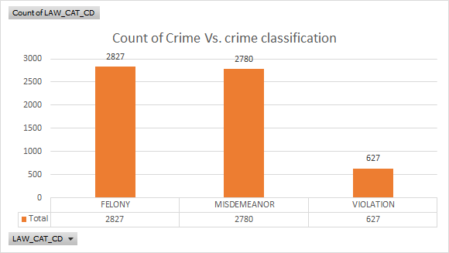
Count of Crimes vs. Crime Classification
Notes:
2 - Aidel
3 - Raad to give a visual presentation of the data reviewed

Slide 7
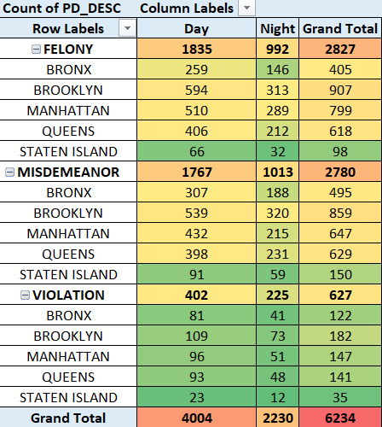
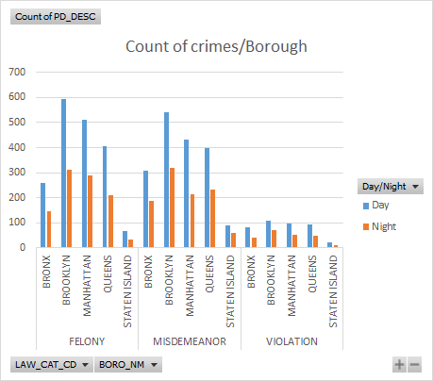
Crime classification based on borough
Notes:
2 - Aidel
3 - Raad to give a visual presentation of the data reviewed

Slide 8
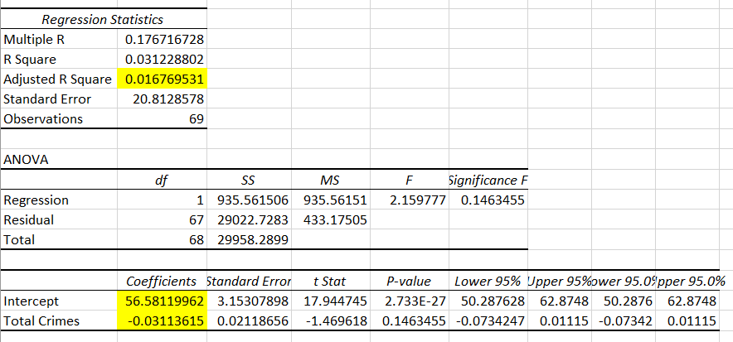
Regression Analysis

Slide 9
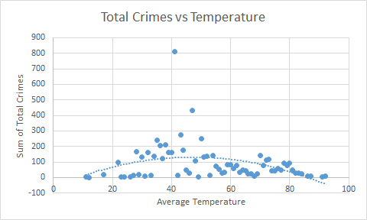
Total Crimes vs Temperature

Slide 10
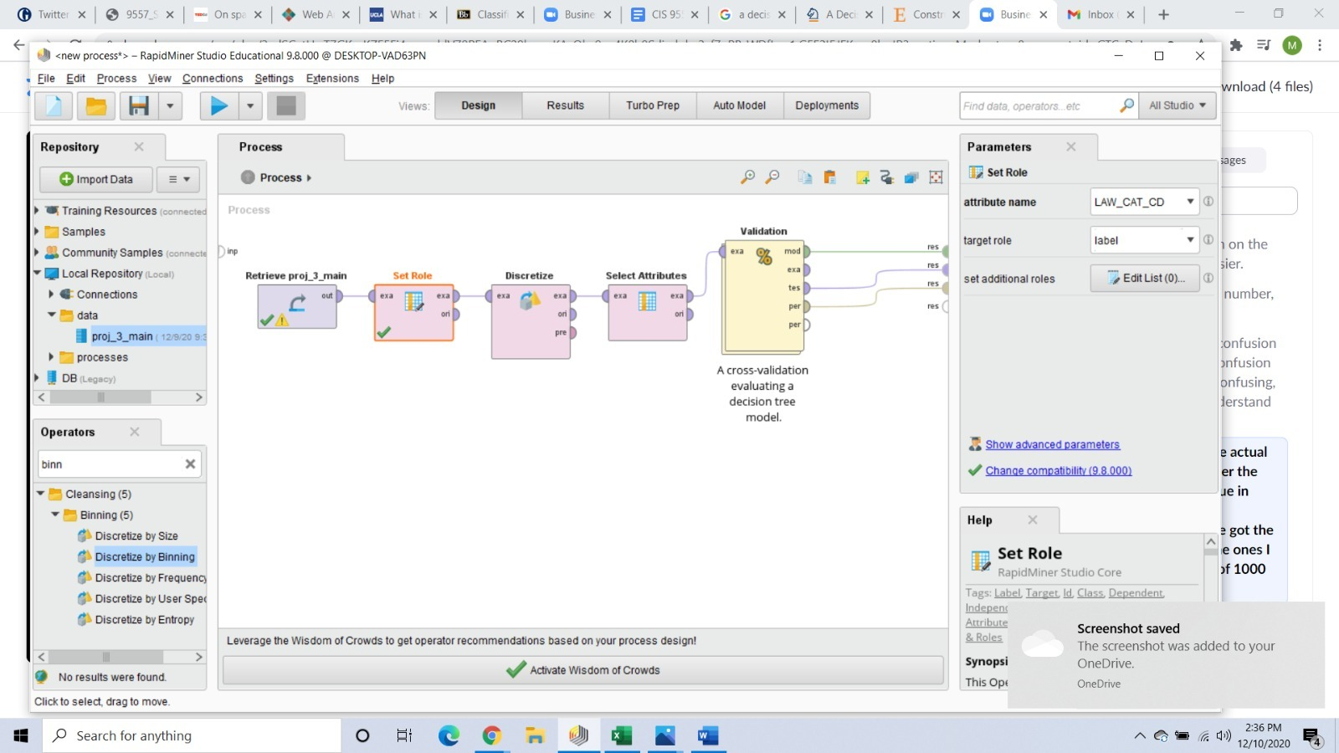
Feature Selection & Engineering

Slide 11
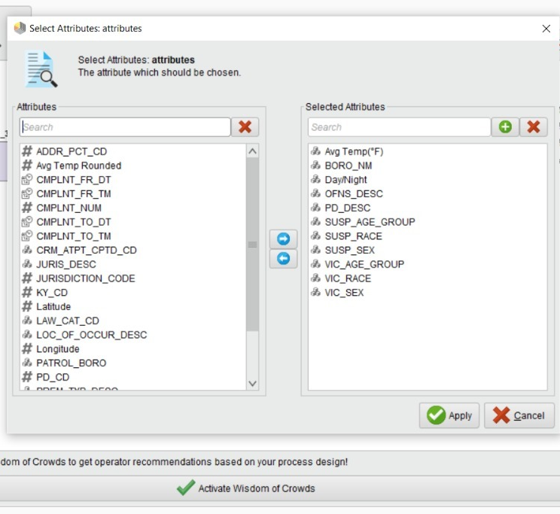
Feature Selection & Engineering

Slide 12
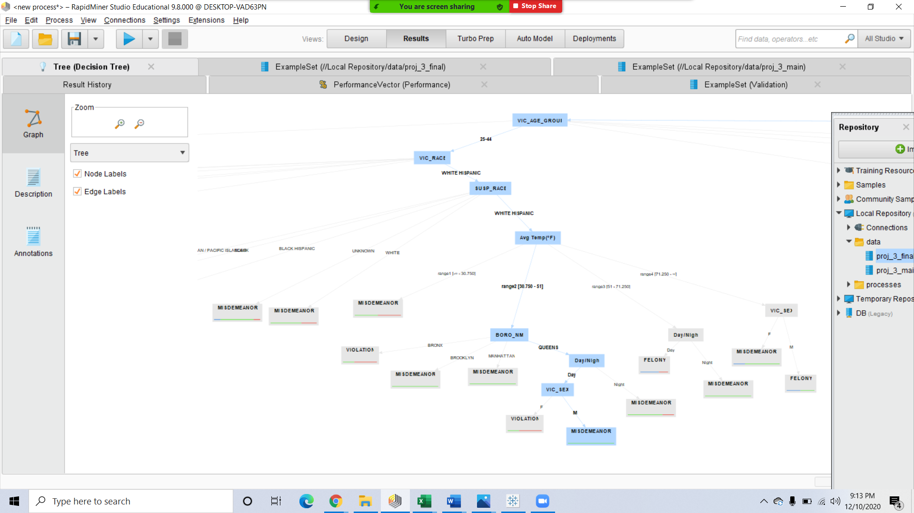
Decision Tree

Slide 13
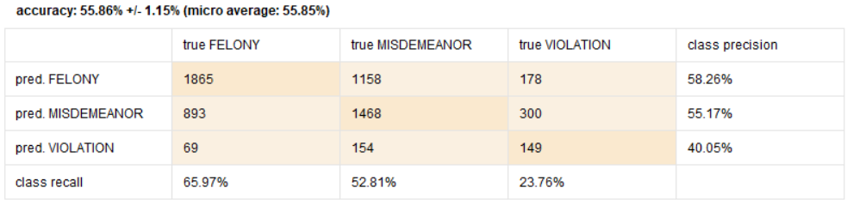
Scoring the Dataset
F-Measure | Felony | Misdemeanor | Violation
Initial F-Measure | 59.64% | 51.28% | 19.81%
New F-Measure | 61.87% | 53.96% | 29.82%

Slide 14
Limitations of Predictive Data
Does not develop beyond existing social problems
Reinforces embedded negative stereotypes
Predictive data
Cannot be relied on to accurately identify future human behaviour
Cannot take into account the circumstances in which a crime is committed
Is constrained to deontological ethics
Notes:
Thank you, Madhuri.
As we discussed this past semester, there is an inherent danger in using a new tool that is not well understood, does not develop beyond existing social problems, and reinforces embedded negative stereotypes. When looking at the data it is important to err on the side of caution. We must take into consideration the nature of predictive data. In reality, a past crime may predict the probability of a future crime, but it can not know the future. The unique human element associated with crime is a major variable that cannot be overlooked. While a computer can be programmed to identify behavioural patterns, it cannot be relied on to accurately identify a future human behaviour.
Predictive analytics is constrained to deontological ethics. While a set of rules can be programmed into RapidMiner and used to judge an action as right or wrong, it is important that we be extra cautious and not put undue importance on data points that cannot understand situational occurrences.

Slide 15
Recommendations for Enhancement
Expand the scope to add at least five years of individual yearly and combined analysis.
Add judiciary outputs, such as verdict, length of time served, and other related categories.
Refer to government sourced data that can ensure a high level of accuracy.
Notes:
Although our goal is to reduce crimes by identifying the patterns related to various levels of offense there are a number of limitations associated with this data. If utilizing this method for practical, real time, scenarios, we recommend expanding the scope to add at least five years of individual yearly and combined analysis. Any useful analysis would also benefit from the addition of judiciary outputs, such as verdict, length of time served, and other related categories. Furthermore, it would be preferable to refer to government sourced data that can ensure a high level of accuracy.
Thank you!

Slide 16
Thank You!

